Slide 1
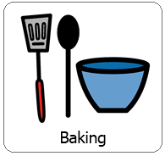
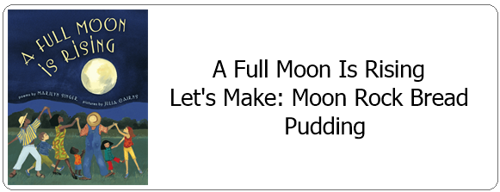
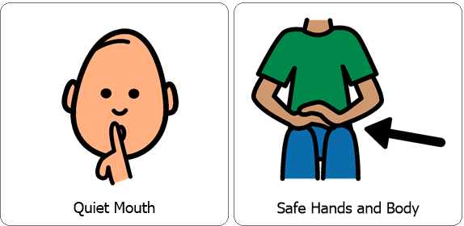
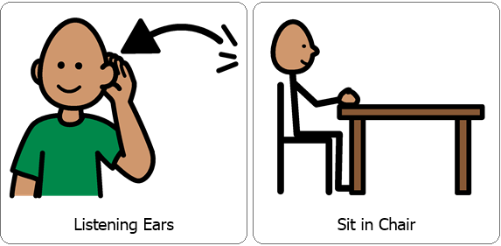
Interactive Cooking Lesson
Review Classroom Expectations

Slide 2
Interactive Cooking Lesson
Hello Parents,
First we read the story “A Full Moon Is Rising”.
You have a couple options here, you can either read the story with your child or watch it on YouTube.
*This is a book of poems, The first page has great information! Then you could choose a couple poems to read with your child!
During the lesson please encourage your child to use their 5 senses, (sight, smell, touch, taste and hearing). You can also practice counting, for example when stirring. While engaging your child in stirring, scooping and pouring you are also encouraging fine motor skills!

Slide 3
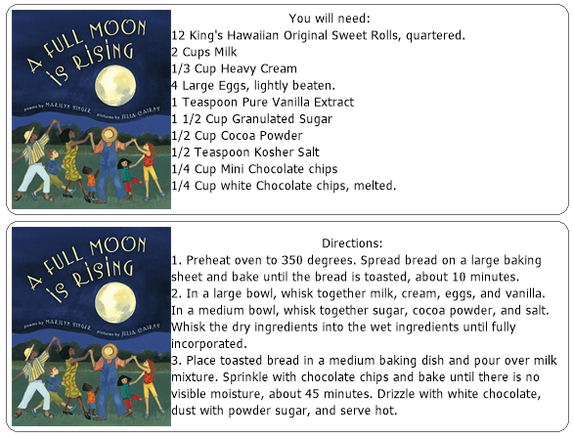
Collect all items necessary prior to the lesson.

Slide 4
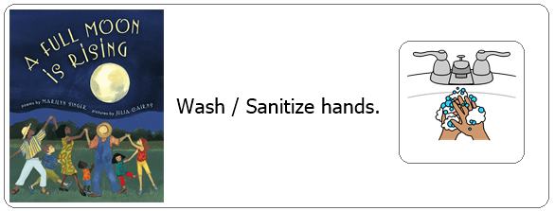
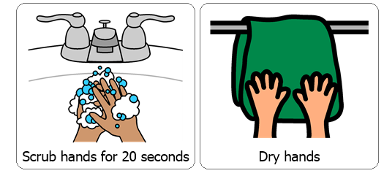
Each cooking lesson begins with each student washing or sanitizing their hands as this is a good life skill.

Slide 5
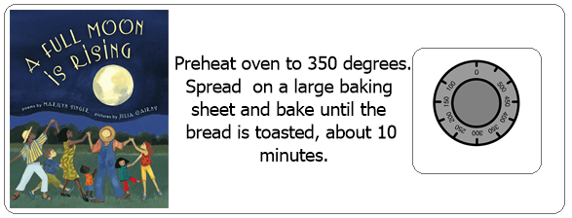

Slide 6
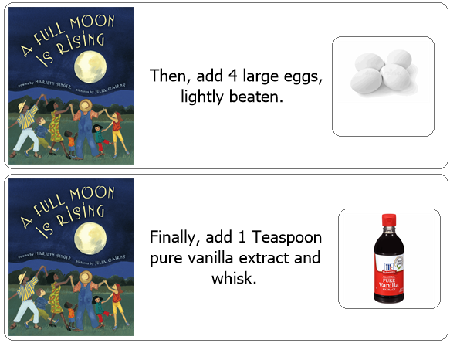

Slide 7
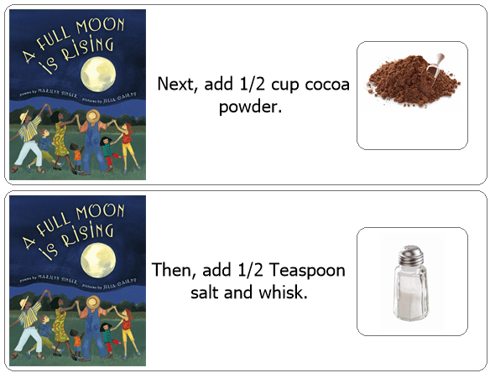
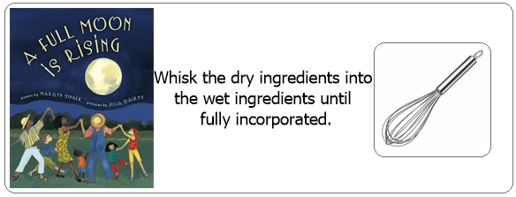

Slide 8
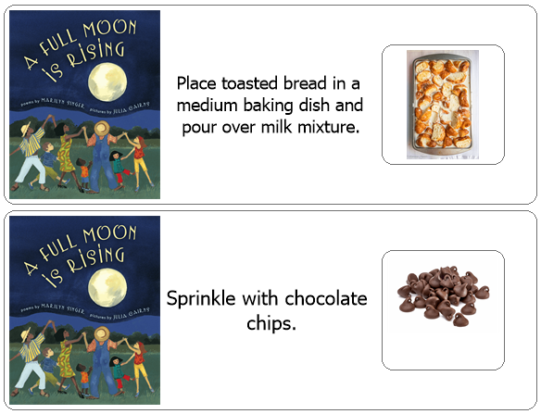
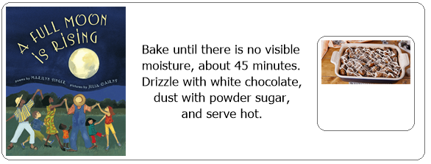

Slide 9
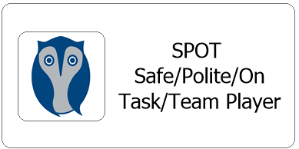
After each cooking lesson we talk about whether or not each student was able to follow classroom expectations, if they were they earn two spot cards, each one is worth 5 minutes.
Did they participate with a quiet mouth, safe hands and body, listening ears and were they able to remain in their seat?
Now this may look different for your child while at home but it is good to revisit and reward for following expectations during lessons. Typically each student works for the same spot reward each day and are able to earn a total of 10 minutes.

