Slide 1
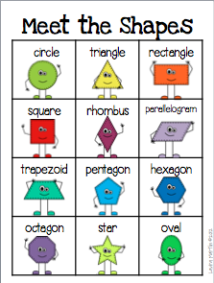
All About Shapes

Slide 2
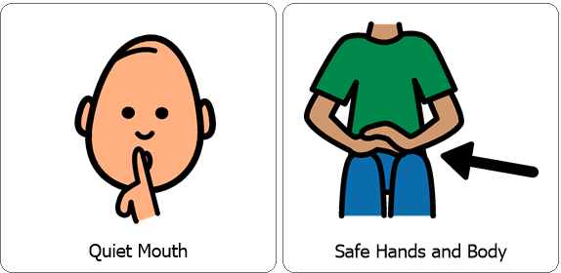
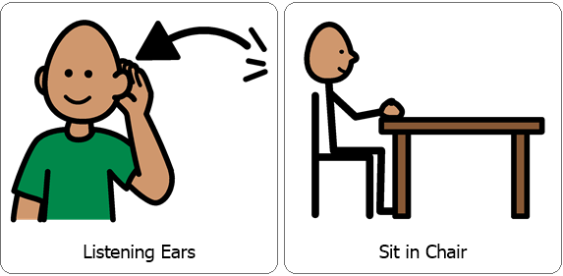
Review Classroom Expectations

Slide 3
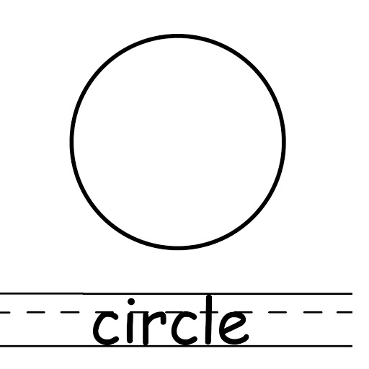
This is a circle. Can you trace the circle?

Slide 4
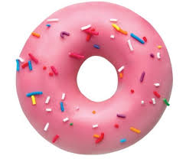
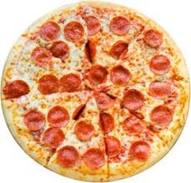
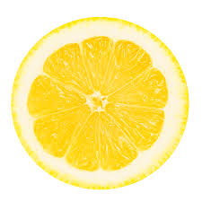
These are real life examples of a circle. Can you count how many circles there are?

Slide 5
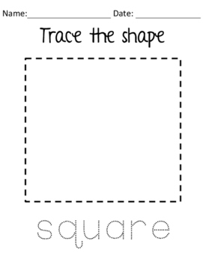
This is a square. Can you trace the square.

Slide 6
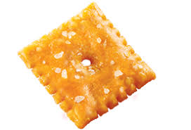
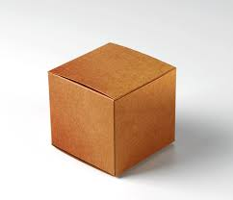
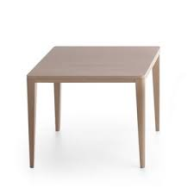
These are real life examples of a square. Can you count how many squares there are?

Slide 7
Point to the Circle.

Slide 8
Point to the Square.

Slide 9
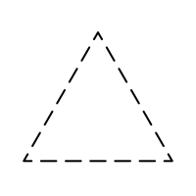
This is a triangle. Have your child trace the triangle.

Slide 10
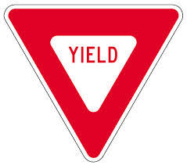
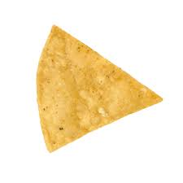
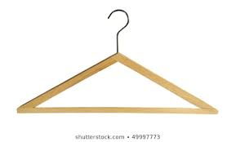
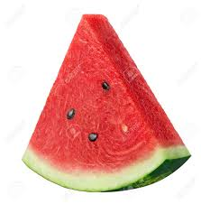
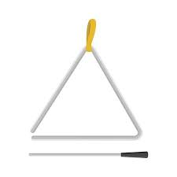
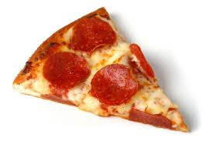
These are real life examples of a triangle. Can you count the triangles.

Slide 11
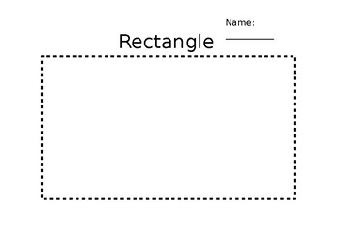
This is a rectangle. Can you trace the rectangle.

Slide 12
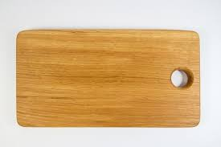
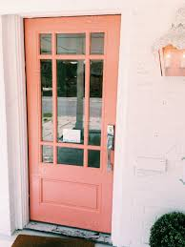
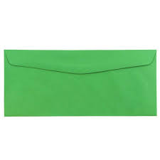
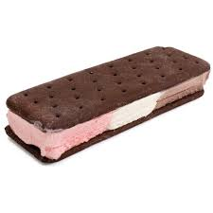
These are real life examples of a rectangle. Can you count the rectangles?

Slide 13
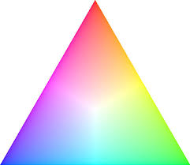
Point to the Triangle.

Slide 14
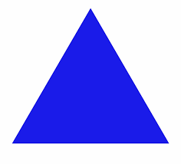
Point to the Rectangle.

Slide 15
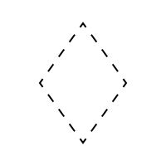
This is a rhombus. Can you trace the rhombus?

Slide 16
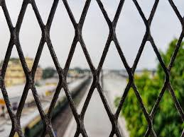
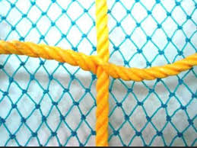
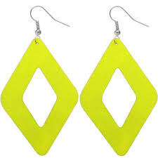
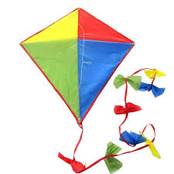
These are real life examples of a rhombus. Can you count the rhombi?

Slide 17
This is a star. Can you trace the star?

Slide 18
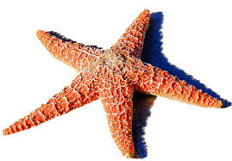
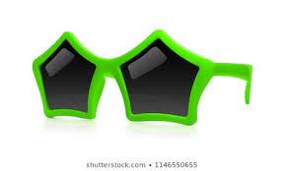
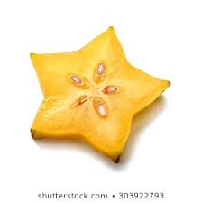
These are real life examples of a star. Can you count the stars?

Slide 19
Point to the Rhombus.

Slide 20
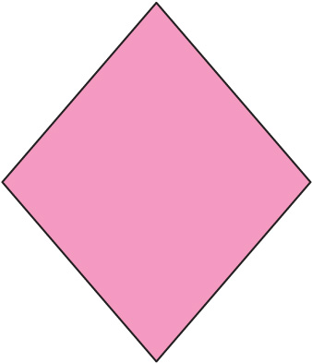
Point to the Star.

Slide 21
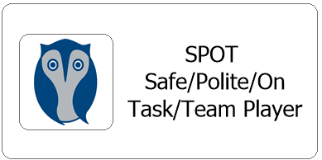
After each lesson we talk about whether or not each student was able to follow classroom expectations, if they were they earn two spot cards, each one is worth 5 minutes with a preferred toy.
Did they participate with a quiet mouth, safe hands and body, listening ears and were they able to remain in their seat?

