Slide 1
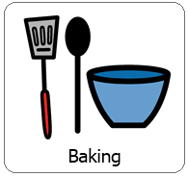
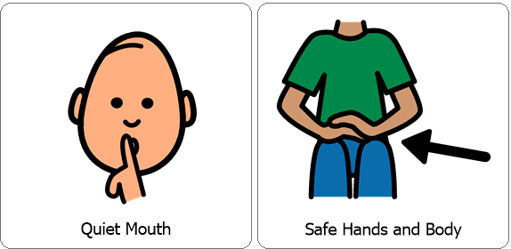
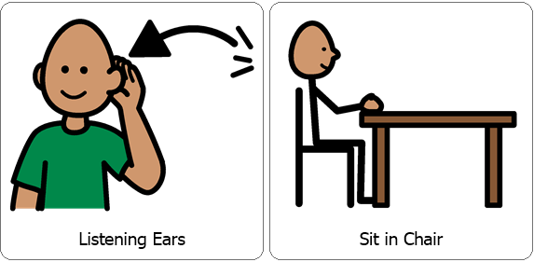
Interactive Cooking Lesson
Dragons Love Tacos
Let’s Make : Tacos
Review Classroom Expectations

Slide 2
Interactive Cooking Lesson
Dragons Love Tacos
Let’s Make : Tacos
Hello Parents,
First we typically read the story paired with our cooking lesson however this week Ms. Maggie has read “Dragons Love Tacos” as part of our ELA lesson. If you would like to view it again you may, otherwise feel free to continue on with this cooking lesson!
During the lesson please encourage your child to use their 5 senses, (sight, smell, touch, taste and hearing). You can also practice counting, for example when stirring. While engaging your child in stirring, scooping and pouring you are also encouraging fine motor skills!

Slide 3
You will need:
*Taco Shells (hard or soft based on your preference)
*Ground Beef with Taco Seasoning (prepare this prior to your lesson)
*Shredded Cheese
*Lettuce
*Diced Tomatoes (Also prepare this prior to your lesson)
*Sour Cream
Review Directions:
Start with a taco shell, hard or soft whichever you prefer.
Next add ground beef with taco seasoning.
Sprinkle Shredded Cheese over protein.
Add desired amount of lettuce.
Evenly disperse diced tomatoes over cheese.
Lastly, add desired amount of Sour Cream!
Collect all items necessary prior to the lesson.

Slide 4
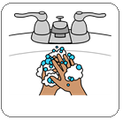
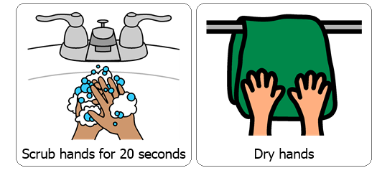
Wash / Sanitize hands
Each cooking lesson begins with each student washing or sanitizing their hands as this is a good life skill.

Slide 5
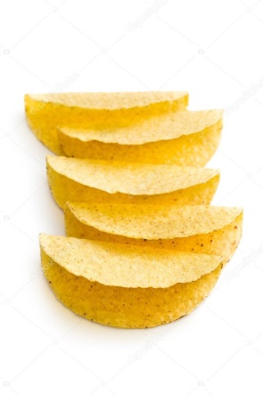
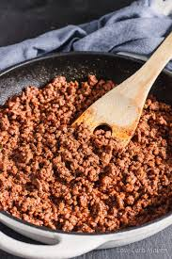
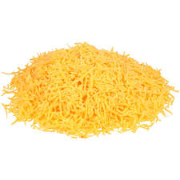
Start with a Taco Shell.
Next add ground beef with taco seasoning.
Sprinkle shredded cheese over protein.

Slide 6
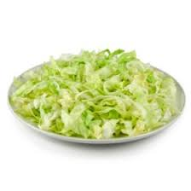
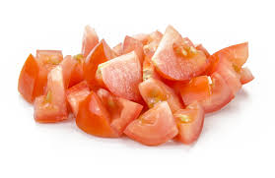
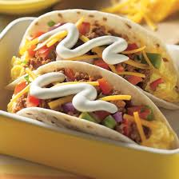
Add desired amount of lettuce.
Evenly disperse diced tomatoes over cheese.
Lastly, add desired amount of sour cream and enjoy!

Slide 7
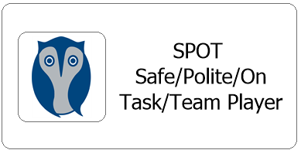
After each cooking lesson we talk about whether or not each student was able to follow classroom expectations, if they were they earn two spot cards, each one is worth 5 minutes.
Did they participate with a quiet mouth, safe hands and body, listening ears and were they able to remain in their seat?
Now this may look different for your child while at home but it is good to revisit and reward for following expectations during lessons. Typically each student works for the same spot reward each day and are able to earn a total of 10 minutes.

