Slide 1
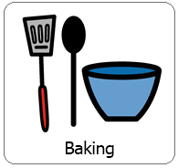
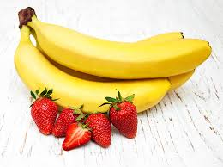
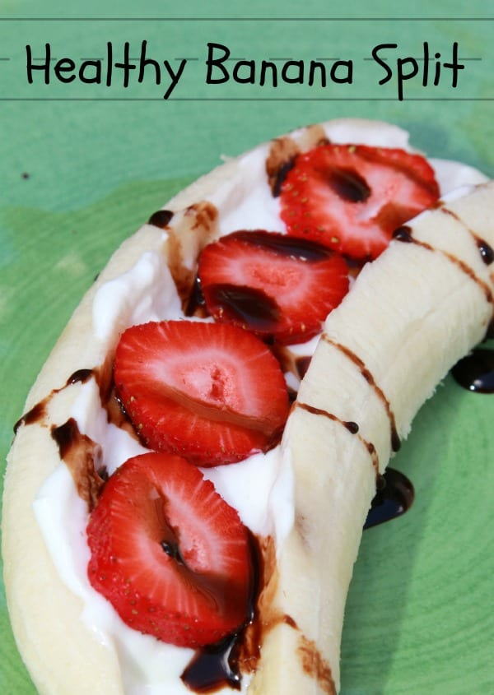
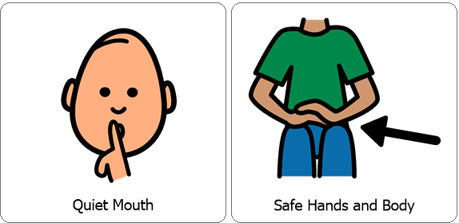
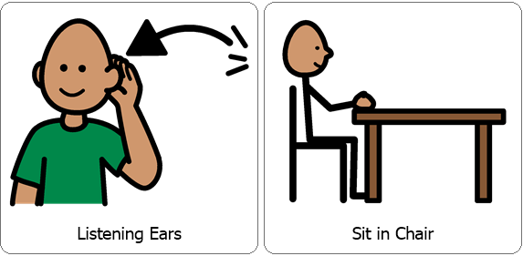
Interactive Cooking Lesson
Let’s Make:
Healthy Banana Split
Review Classroom Expectations

Slide 2
Interactive Cooking Lesson
Let’s Make:
Healthy Banana Split
During the lesson please encourage your child to use their 5 senses, (sight, smell, touch, taste and hearing). You can also practice counting, for example when stirring. While engaging your child in stirring, scooping and pouring you are also encouraging fine motor skills!

Slide 3
You will need:
*1 Ripe Banana,
*Strawberries (Cut into slices)
Feel free to add additional fruit as desired, For example blueberries, raspberries or blackberries.
*1 Vanilla yogurt cup
*Chocolate syrup
Review Directions:
Cut banana down the middle the long direction.
Fill the banana with vanilla yogurt.
Add Strawberry slices. (Feel free to add other fruit as desired)
Drizzle chocolate syrup over your banana split.
Enjoy!
Collect all items necessary prior to the lesson.

Slide 4
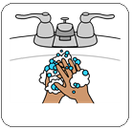
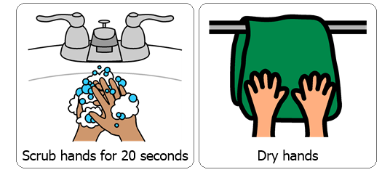
Wash / Sanitize hands
Each cooking lesson begins with each student washing or sanitizing their hands as this is a good life skill.

Slide 5
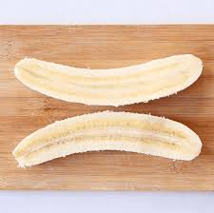
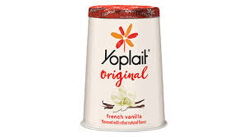
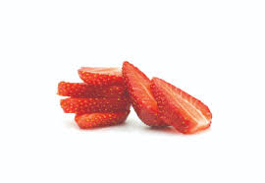
Cut banana down the middle the long direction.
Fill the banana with vanilla yogurt.
Add Strawberry slices. (Feel free to add other fruit as desired)

Slide 6
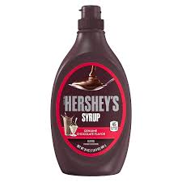
Drizzle chocolate syrup over your banana split.

Slide 7
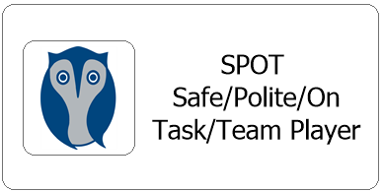
After each cooking lesson we talk about whether or not each student was able to follow classroom expectations, if they were they earn two spot cards, each one is worth 5 minutes.
Did they participate with a quiet mouth, safe hands and body, listening ears and were they able to remain in their seat?
Now this may look different for your child while at home but it is good to revisit and reward for following expectations during lessons. Typically each student works for the same spot reward each day and are able to earn a total of 10 minutes.

