Slide 1
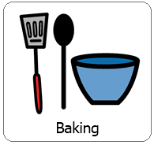
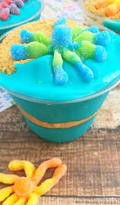
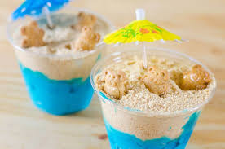
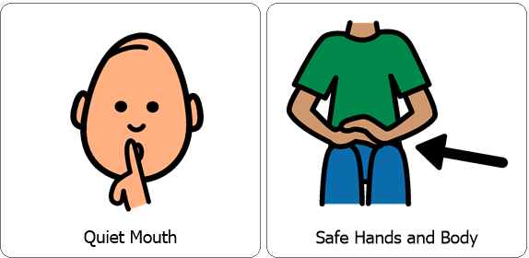
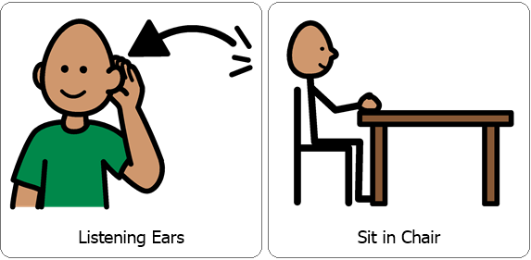
Interactive Cooking Lesson
Let’s Make:
Ocean Pudding Cups!
Review Classroom Expectations

Slide 2
Interactive Cooking Lesson
Let’s Make:
Ocean Pudding Cups!
During the lesson please encourage your child to use their 5 senses, (sight, smell, touch, taste and hearing). You can also practice counting, for example when stirring. While engaging your child in stirring, scooping and pouring you are also encouraging fine motor skills!

Slide 3
You will need:
*5.1 oz box instant vanilla pudding
*2 Cups milk
*Blue food coloring
*Graham Crackers
*Gummy Octopus, Goldfish or Teddy Graham Bears for fun!
Review Directions:
In a large bowl, mix together your vanilla pudding, milk and a blue food coloring then whisk. Add food coloring until a desired shade of blue is reached.
Set pudding in the fridge for about 5 minutes until set.
Place graham crackers in a large Ziploc bag and have your child help you smash the crackers.
Fill the bottom of your cups ¼ way with your graham cracker crumbs (representing the ocean floor). Then layer with blue pudding (for the ocean water) and top with graham cracker (representing a beach).
Finally, top with Gummy shark, Goldfish or Teddy Graham Bears!
Collect all items necessary prior to the lesson.

Slide 4
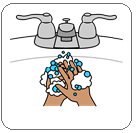
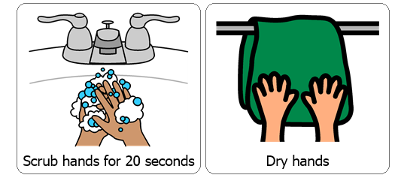
Wash / Sanitize hands
Each cooking lesson begins with each student washing or sanitizing their hands as this is a good life skill.

Slide 5
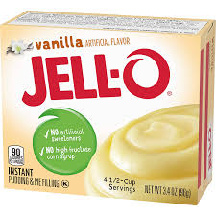
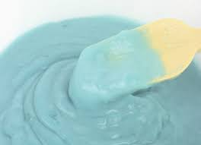
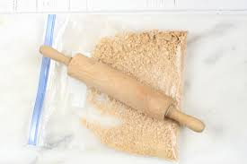
In a large bowl, mix together your vanilla pudding, milk and a blue food coloring then whisk. Add food coloring until a desired shade of blue is reached.
Set pudding in the fridge for about 5 minutes until set.
Place graham crackers in a large Ziploc bag and have your child help you smash the crackers.

Slide 6
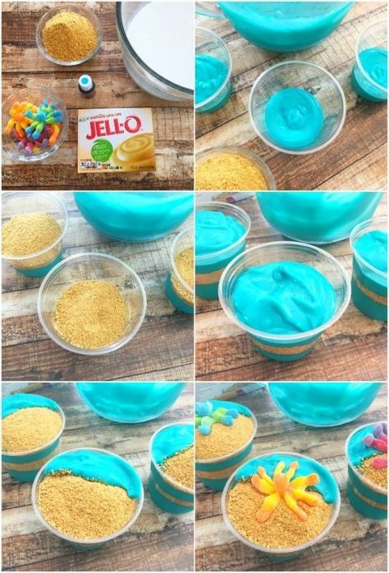
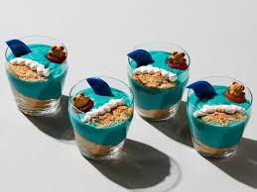
Fill the bottom of your cups ¼ way with your graham cracker crumbs (representing the ocean floor). Then layer with blue pudding (for the ocean water) and top with graham cracker (representing a beach).
Finally, top with Gummy shark, Goldfish or Teddy Graham Bears!

Slide 7
After each cooking lesson we talk about whether or not each student was able to follow classroom expectations, if they were they earn two spot cards, each one is worth 5 minutes.
Did they participate with a quiet mouth, safe hands and body, listening ears and were they able to remain in their seat?
Now this may look different for your child while at home but it is good to revisit and reward for following expectations during lessons. Typically each student works for the same spot reward each day and are able to earn a total of 10 minutes.

