Slide 1
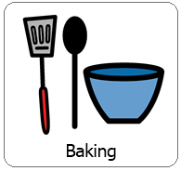
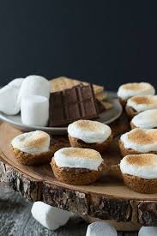
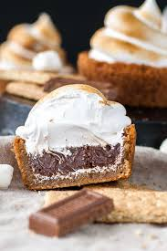
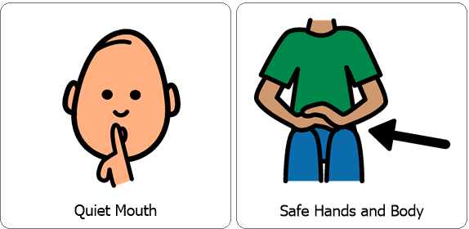
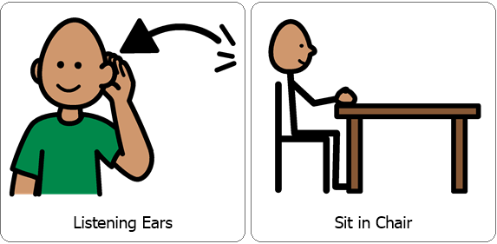
Interactive Cooking Lesson
Let’s Make:
S’mores Bites!
Review Classroom Expectations

Slide 2
Interactive Cooking Lesson
Let’s Make:
S’mores Bites!
During the lesson please encourage your child to use their 5 senses, (sight, smell, touch, taste and hearing). You can also practice counting, for example when stirring. While engaging your child in stirring, scooping and pouring you are also encouraging fine motor skills!

Slide 3
You will need:
*7 Whole graham crackers (equals 1 cup finely crushed)
*1/4 cup powdered sugar
*6 tablespoons butter, melted
*2 (1.55 oz) milk chocolate Hershey bars, divided into rectangles.
*12 Large marshmallows,, cut in half using scissors.
Review Directions:
Preheat the oven to 350 degrees.
Place 7 graham crackers in a large Ziploc bag and have your child help you smash the crackers.
Combine graham cracker crumbs, ¼ cup powdered sugar and 6 tablespoons melted butter into a small bowl.
Evenly divide crumb mixture into each cup of a 24 cup mini muffin pan, grease slightly before using. Press crumbs down to form shallow cups.
Bake 4-5 minutes or until edges are golden.
Next, place one chocolate rectangle into each cup, place one marshmallow half, cut side down into each cup.
Return to oven for 2-4 minutes or until marshmallows are softened.
Cool and Enjoy!

Slide 4
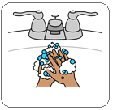
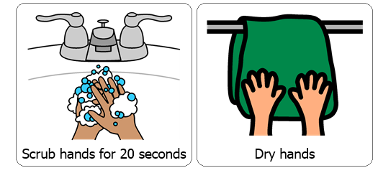
Wash / Sanitize hands
Each cooking lesson begins with each student washing or sanitizing their hands as this is a good life skill.

Slide 5
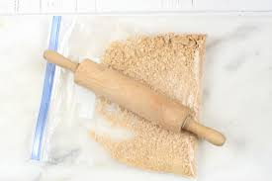
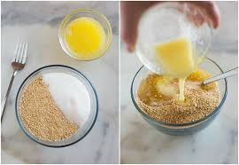
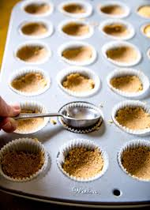
First, preheat the oven to 350 degrees. Then, place 7 graham crackers in a large Ziploc bag and have your child help you smash the crackers.
Combine graham cracker crumbs, ¼ cup powdered sugar and 6 tablespoons melted butter into a small bowl.
Evenly divide crumb mixture into each cup of a 24 cup mini muffin pan, grease slightly before using. Press crumbs down to form shallow cups.
Bake 4-5 minutes or until edges are golden

Slide 6
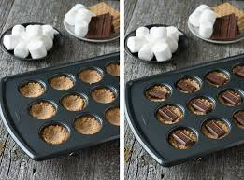
Next, place one chocolate rectangle into each cup, place one marshmallow half, cut side down into each cup.
Return to oven for 2-4 minutes or until marshmallows are softened.
Cool and Enjoy!

Slide 7
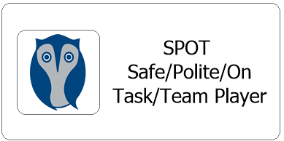
After each cooking lesson we talk about whether or not each student was able to follow classroom expectations, if they were they earn two spot cards, each one is worth 5 minutes.
Did they participate with a quiet mouth, safe hands and body, listening ears and were they able to remain in their seat?
Now this may look different for your child while at home but it is good to revisit and reward for following expectations during lessons. Typically each student works for the same spot reward each day and are able to earn a total of 10 minutes.

