Slide 1
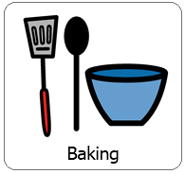
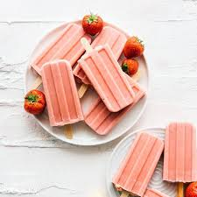
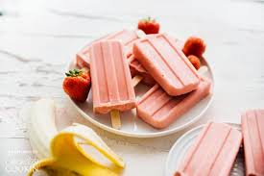
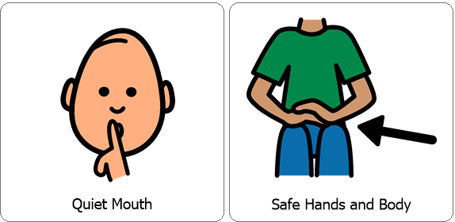
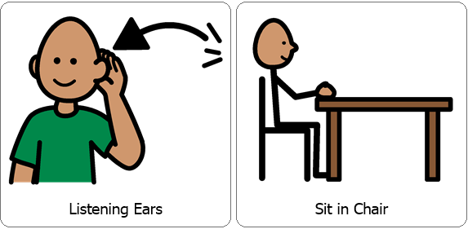
Interactive Cooking Lesson
Let’s Make:
Strawberry Banana Smoothie Popsicle's!
Review Classroom Expectations

Slide 2
Interactive Cooking Lesson
Let’s Make:
Strawberry Banana Smoothie Popsicle's!
During the lesson please encourage your child to use their 5 senses, (sight, smell, touch, taste and hearing). You can also practice counting, for example when stirring. While engaging your child in stirring, scooping and pouring you are also encouraging fine motor skills!

Slide 3
You will need:
*5 ish Ripe strawberries, the riper, the better.
*1 Banana (equally as ripe as the strawberries)
*1 Vanilla or Strawberry yogurt cup
*Popsicle mold
*Blender
Increase number of ingredients if you want more than 4 popsicles.
Review Directions:
Snip the tops of the strawberries off and place them in the blender.
Peel the banana and add to blender.
Pour the whole yogurt cup in (it doesn’t matter what size it is.)
Blend until smooth.
Pour into molds and freeze for 3-4 hours.
Collect all items necessary prior to the lesson.

Slide 4
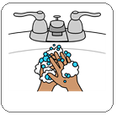
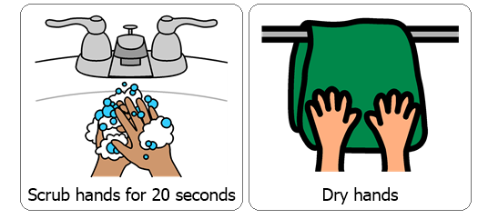
Wash / Sanitize hands
Each cooking lesson begins with each student washing or sanitizing their hands as this is a good life skill.

Slide 5
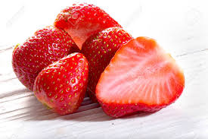
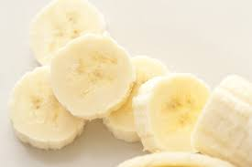
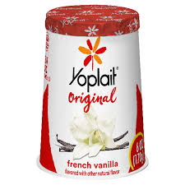
Snip the tops of the strawberries off and place them in the blender.
Peel the banana and add to blender.
Pour the whole yogurt cup in (it doesn’t matter what size it is.)

Slide 6
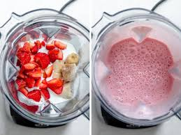
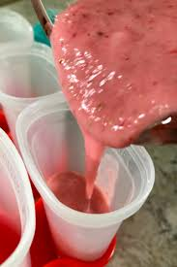
Blend until smooth.
Pour into molds and freeze for 3-4 hours.

Slide 7
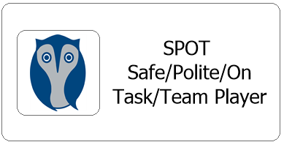
After each cooking lesson we talk about whether or not each student was able to follow classroom expectations, if they were they earn two spot cards, each one is worth 5 minutes.
Did they participate with a quiet mouth, safe hands and body, listening ears and were they able to remain in their seat?
Now this may look different for your child while at home but it is good to revisit and reward for following expectations during lessons. Typically each student works for the same spot reward each day and are able to earn a total of 10 minutes.

